Slide 1
Object-Oriented Programming
Week 2 | Lecture 1

Slide 2
What is an Object?
An object is:
Anything for which we want to save information
Something tangible (e.g. Cat, Car)
Something that can be captured intellectually
An object has:
State/Attribute/Properties/Data
Well-defined Behavior/Methods/Functions

Slide 3
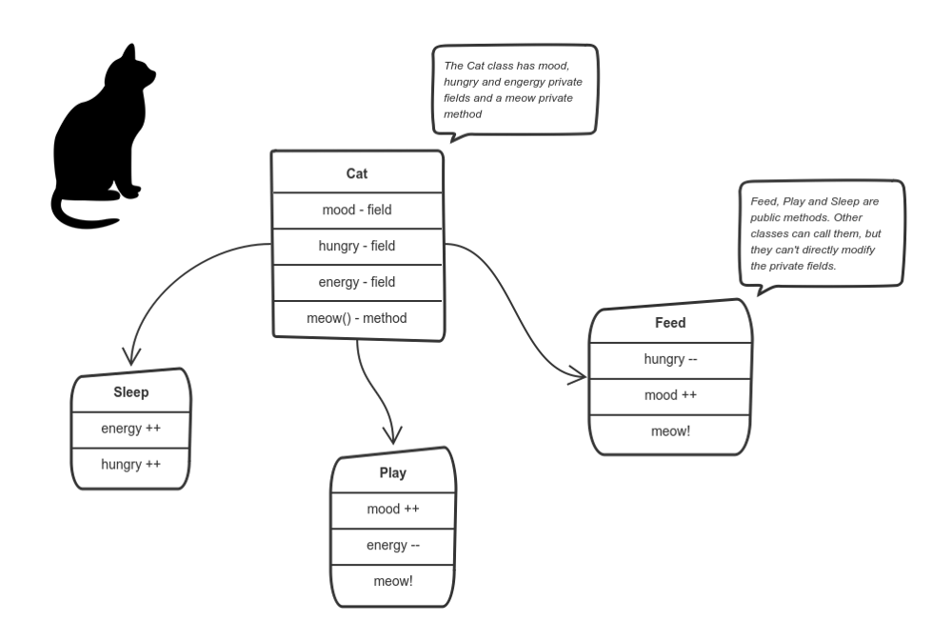

Slide 4
Exercise
Are there any ‘objects’ in this classroom?

Slide 5
Exercise
Are there any ‘objects’ in this classroom
Chair
Multimedia
Student
Teacher

Slide 6
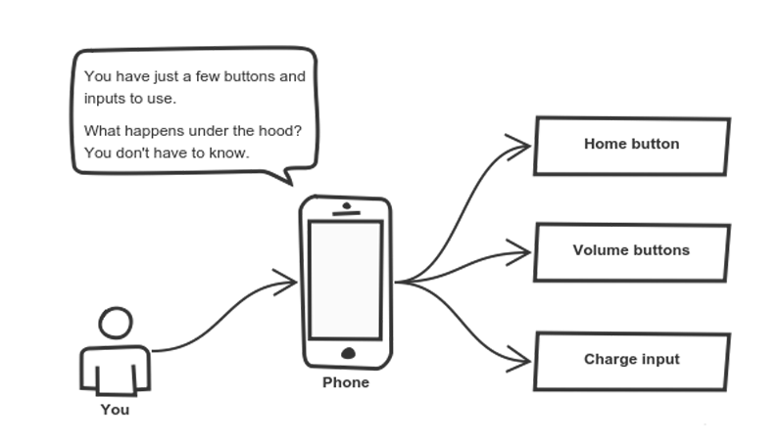

Slide 7
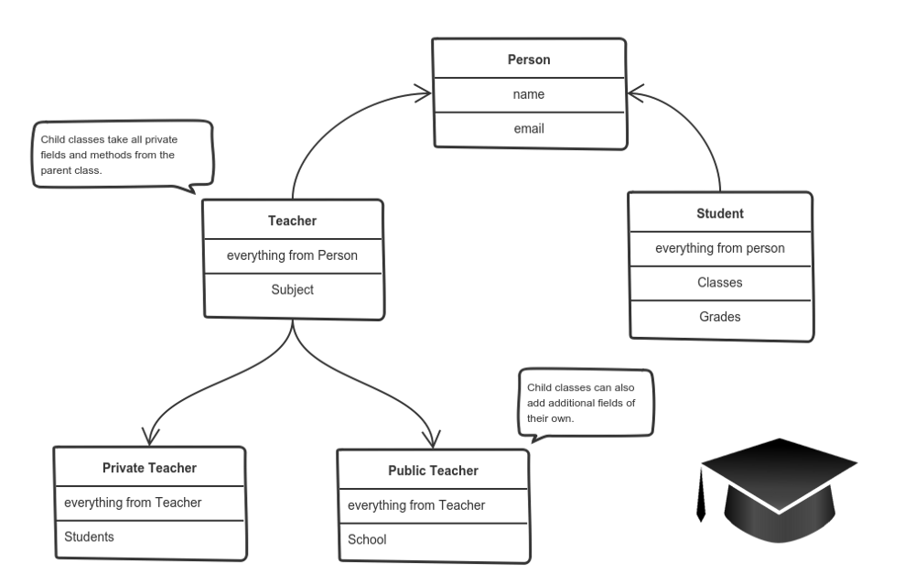

Slide 8
Exercise
Possible Objects in this university?

Slide 9
• Model is the abstraction of some real word scenario. It helps us to understand that scenario. • Object oriented model of any scenario (problem) describes that scenario (problem) in the form of interacting objects. • We use Object Orientation because it helps us in mapping real world problem in a programming language. • Object Orientation is achieved using objects and their relationships. • Properties of an object are described using its data members and behavior of an object is described using its functions

Slide 10
• Objects may be tangible (physical) or intangible (also called conceptual or virtual). • Generally when we have given a certain problem description, nouns in that problem description are candidates for becoming objects of our system. • There may be more than one aspects of an object • It is not necessary that every object has a specific role in implementation of a problem there may be some objects without any role, like school parking in our school.
• It is easier to develop programs using Object Oriented Programming because it is closer to real life.

